Slide 2
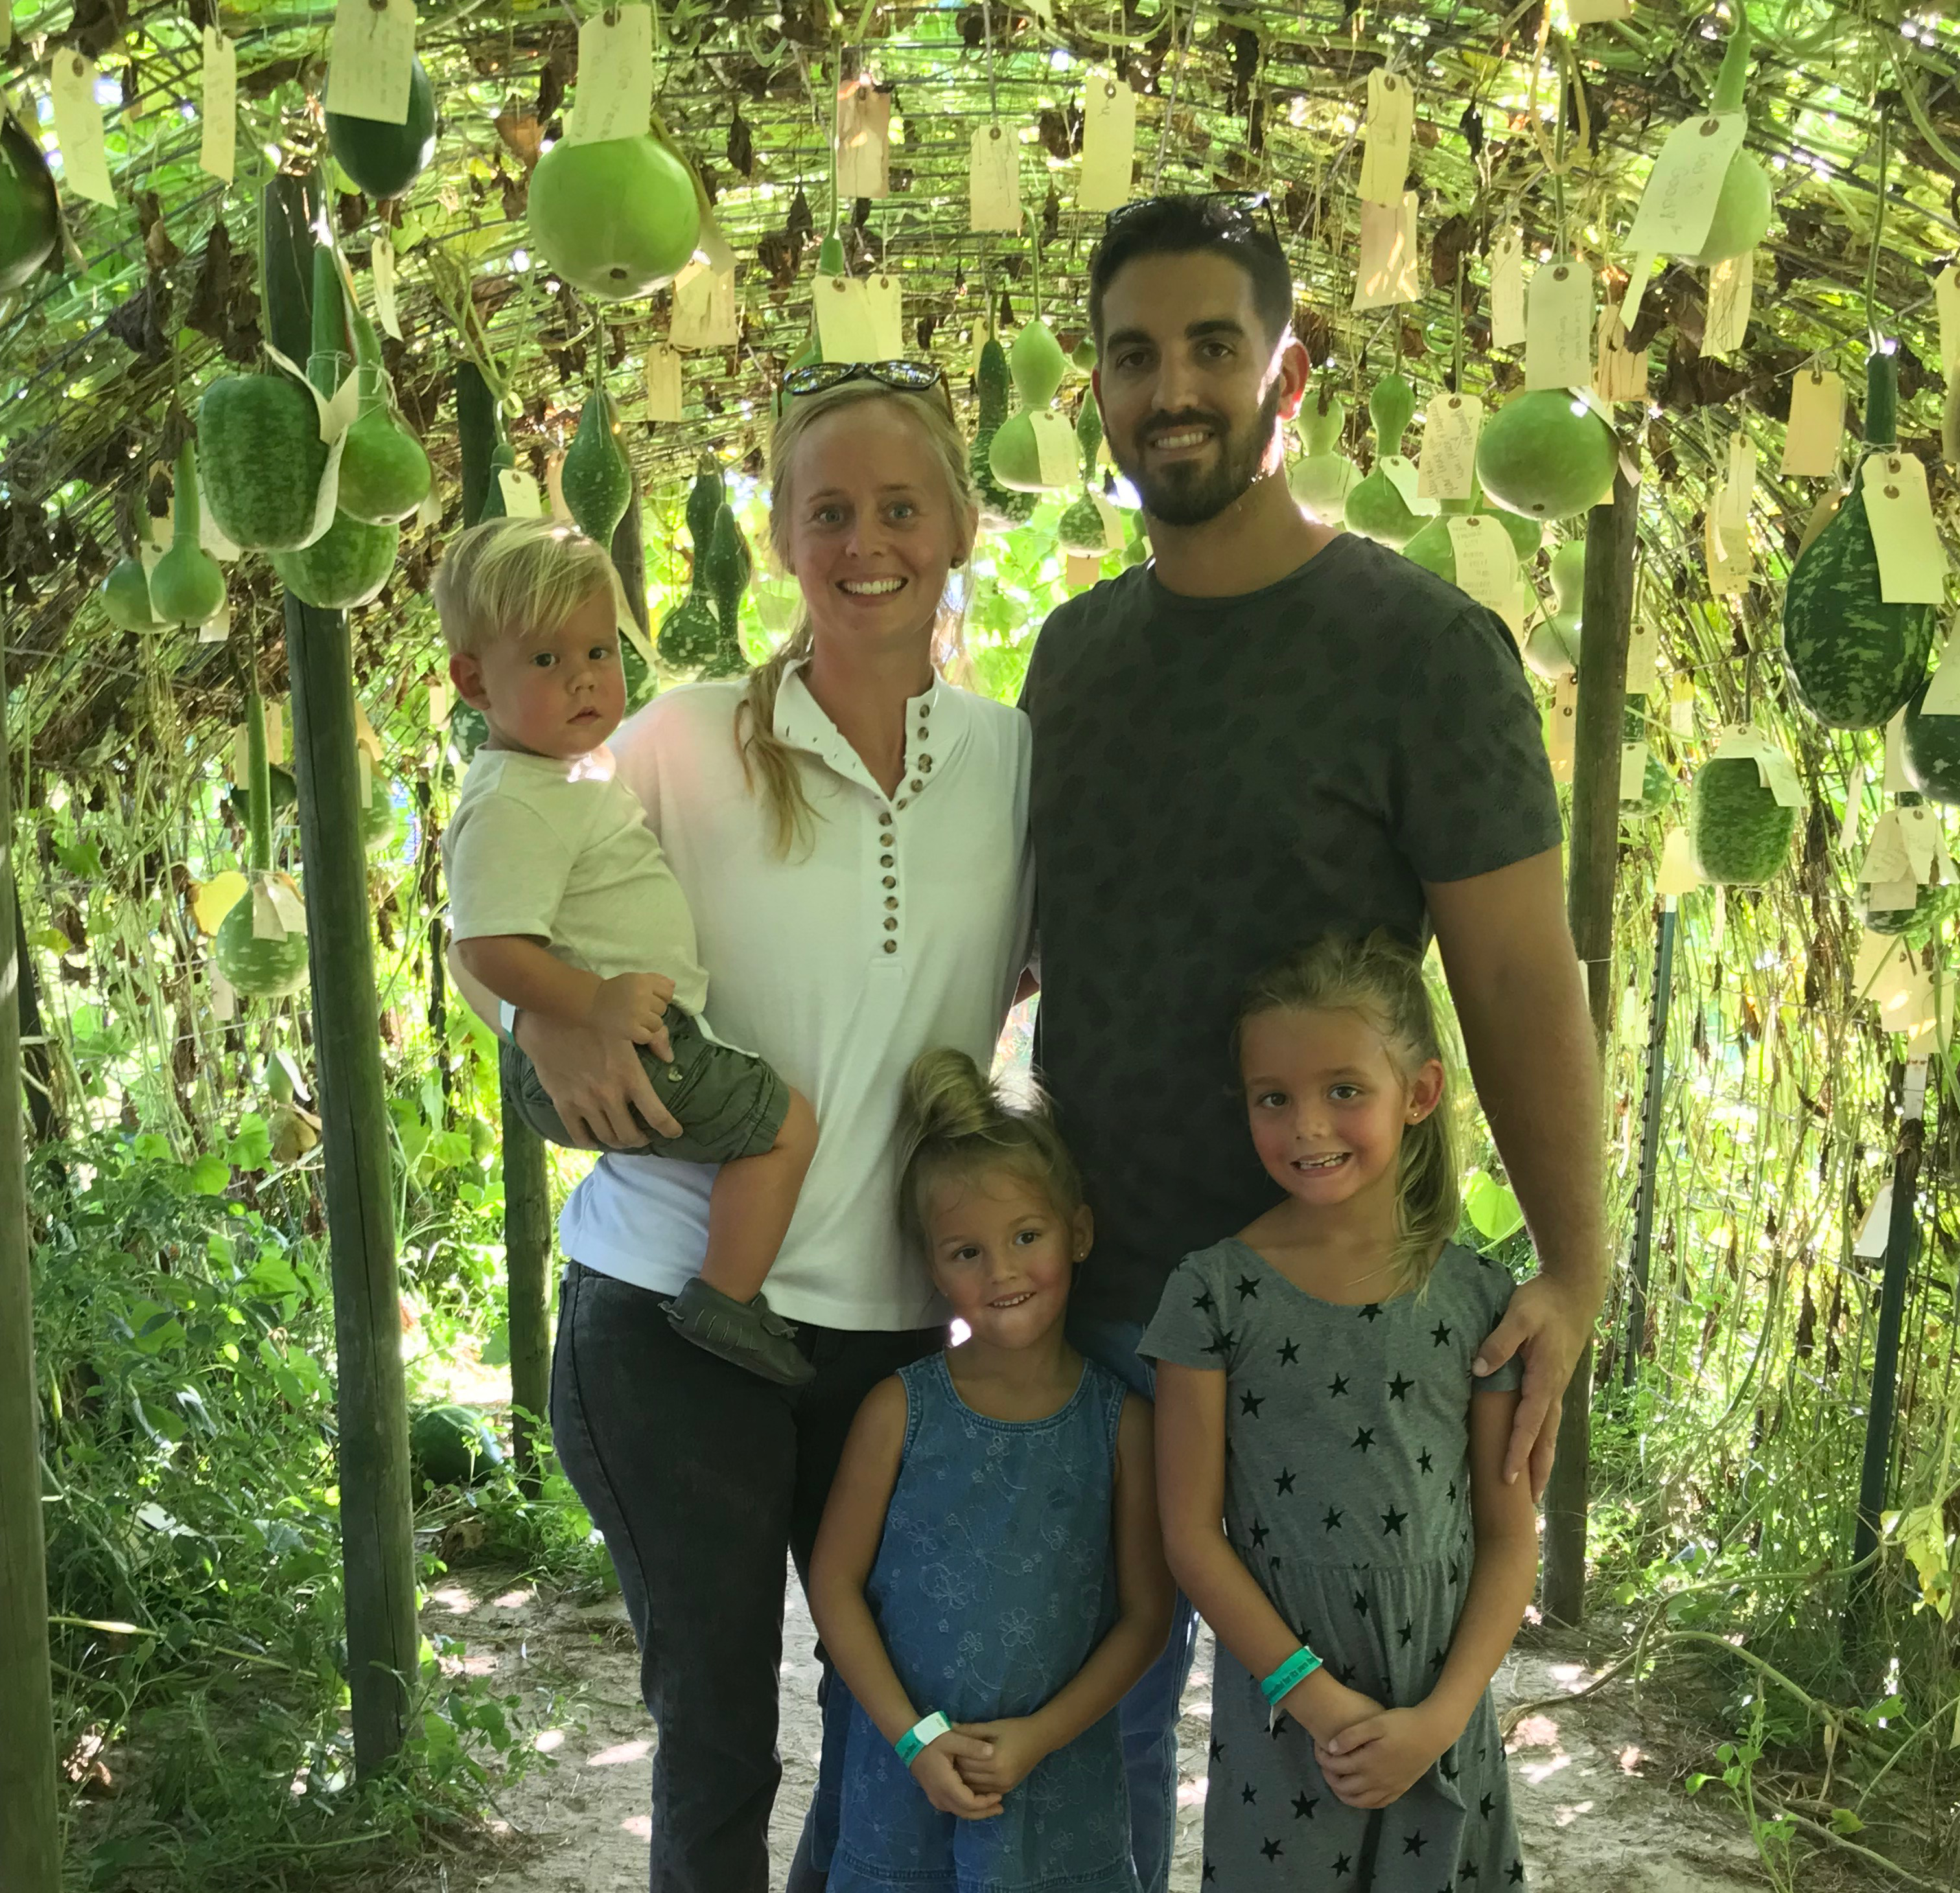

Slide 3
The Heart of a Church Planter

Slide 4
The Heart of a DISCIPLE

Slide 5
Proverbs 3:5-6
5 Trust in the LORD with all thine heart; and lean not unto thine own understanding.
6 In all thy ways acknowledge him, and he shall direct thy paths.
Mission Focus

Slide 6
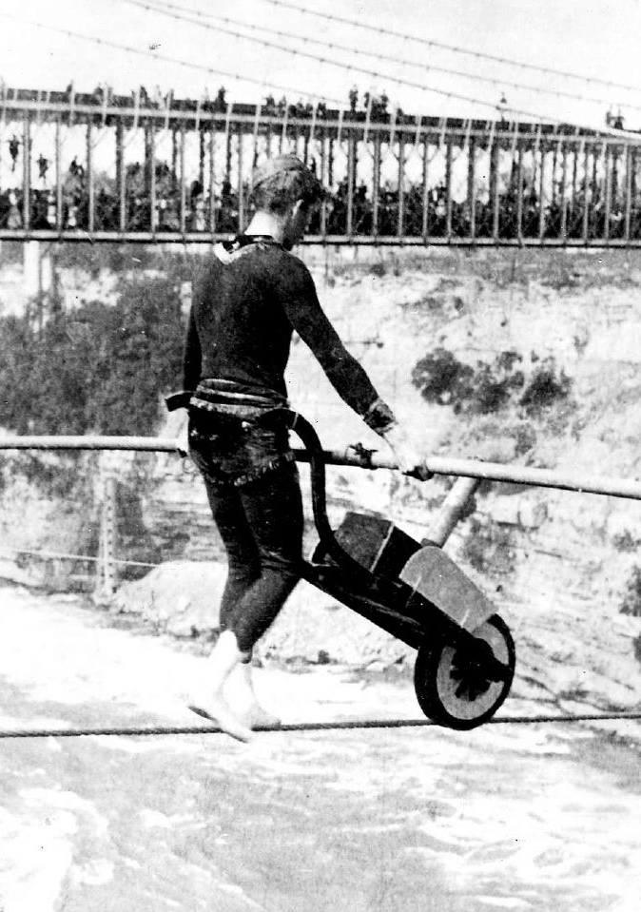
“There is a big difference in
saying
you trust and demonstrating
you trust!”
Proverbs 3:5-6

Slide 7
“If God directs it, no man can stop it.
If man directs it, no man can keep it going.”
Mission Focus 2019

Slide 8
1. You must TRUST the lord ENTIRELY
Proverbs 3:5-6
Psalm 28:7 The LORD is my strength and my shield; my heart TRUSTED IN HIM, and I am helped: therefore my heart greatly rejoiceth; and with my song will I praise him.
Psalm 4:5 … and PUT your trust in the LORD.
Pslam 9:10 … And they that know thy name will PUT their trust in thee: for thou, LORD, hast not forsaken them that seek thee.
Psalm 17:7 Shew thy marvellous lovingkindness, O thou that savest by thy right hand them which PUT their trust in thee from those that rise up against them.

Slide 9
2. You must TRUST the lord EXCLUSIVELY
Proverbs 3:5-6
Lean-To bend or incline so as to rest on something.
Philippians 3:3 … and have no confidence in the flesh.
Jeremiah 17:5 Thus saith the LORD; Cursed be the man that trusteth in man, and maketh flesh his arm, and whose heart departeth from the LORD.
Jeremiah 17:7-8 Blessed is the man that trusteth in the LORD, and whose hope the LORD is. …neither shall cease from yielding fruit.

Slide 10
“For my thoughts are not your thoughts, neither are your ways my ways, saith the Lord. 9 For as the heavens are higher than the earth, so are my ways higher than your ways, and my thoughts than your thoughts.”
Isaiah 55:8-9

Slide 11
3. You must TRUST the lord IN Everything
Proverbs 3:5-6
Acknowledge-recognition, to own or notice with particular regard.
1 Corinthians 10:31 Whether therefore ye eat, or drink, or whatsoever ye do, do all to the glory of God.
You acknowledge him through PRAYER
A day without prayer is you telling God, “I got this!”

Slide 12
REMEMBER:
There is a big difference in
saying
you trust GOD and demonstrating
you trust GOD!”
Proverbs 3:5-6

Slide 13
1. IF you trust God, you will LEAN on his PROMISES
Proverbs 3:5-6
Do you KNOW his promises to trust them?

Slide 14
“Take the promises of God. Let a man feed for a month on the promises of God, and he will not talk about how poor he is. You hear people say, ‘Oh, my leanness! How lean I am!’ It is not their leanness, it is their laziness. If you would only read from Genesis to Revelation and see all the promises made by God to Abraham, to Isaac, to Jacob, to the Jews and to the Gentiles, and to all His people everywhere…
D.L. Moody

Slide 15
if you would spend a month feeding on the precious promises of God—you wouldn’t be going about complaining how poor you are. You would lift up your head and proclaim the riches of His Grace, because you couldn’t help FROM doing it!”
D.L. Moody

Slide 16
1. IF you trust God, you will LEAN on his PROMISES
Proverbs 3:5-6
Do you KNOW his promises to trust them?
Does your life demonstrate that you LEAN on the promises of God?

Slide 17
1. IF you trust God, you will LEAN on his PROMISES
Proverbs 3:5-6
2. IF you trust God, you will LEAN on his PRINCIPLES
Do you KNOW his principles to trust them?
Does your life demonstrate that you LEAN on biblical principles?

Slide 18
1. IF you trust God, you will LEAN on his PROMISES
Proverbs 3:5-6
2. IF you trust God, you will LEAN on his PRINCIPLES
3. IF you trust God, you will LEAN on his Processes
Do you KNOW his processes to trust them?
Does your life demonstrate that you LEAN on biblical processes?

Slide 19
REMEMBER:
There is a big difference in
saying
you trust GOD and demonstrating
you trust GOD!”
Proverbs 3:5-6

Slide 20
“If God directs it, no man can stop it.
If man directs it, no man can keep it going.”
Mission Focus 2019

Slide 21
“God is looking for people through whom HE can do the impossible. What a pity we plan only things we can do by ourselves.”
A.W. Tozer

Slide 22
The Heart of a Church Planter

Slide 23
The Heart of a DISCIPLE

